Slide 1

Big Data Project Group 06
Akshitha Mohan Shirva
Arjun Singh Pathania
Jigisha Shah
Pooja Mohan Paturkar
Trisha Tukesh Gaur

Slide 2
Objective
Identify commercial truck drivers in California who possess the highest risk factors to apply focused safety measures.
1
Analyze vehicle-specific event and location data to uncover trends and opportunities for enhancing truck safety.
2
Assess truck models by average risk factor to identify potentially hazardous vehicles and recommend safety improvements.
3
Use geospatial analysis to determine high-priority cities and areas within California for targeted interventions.
4
Create informative visualizations in Tableau to drive decision-making and further improve safety strategies.
5

Slide 3
Process Flow
Data Ingestion:
Cloudera: Files are loaded into the Cloudera server's local directory.
HDFS: The files are moved from the local directory to the Hadoop Distributed File System (HDFS) for distributed storage.
Data Processing:
Hive/Impala: Tables are created in Hive or Impala, and the data from HDFS is loaded into these tables for structured querying and analysis.
Tableau:
A data model is created in Tableau.
Tableau is connected to Cloudera Hadoop to access the data in HDFS.
Additional tables are created for analyzing risk factors.
Regression analysis is performed using Rserve integrated with Tableau.
R andPython:
R and Python is used for the statistical modeling and analysis, particularly for the regression analysis
Insights and Conclusion:
The results of the analysis are visualized in Tableau.
Insights and conclusions are drawn from the analysis
Data Analysis and Visualization:

Slide 4
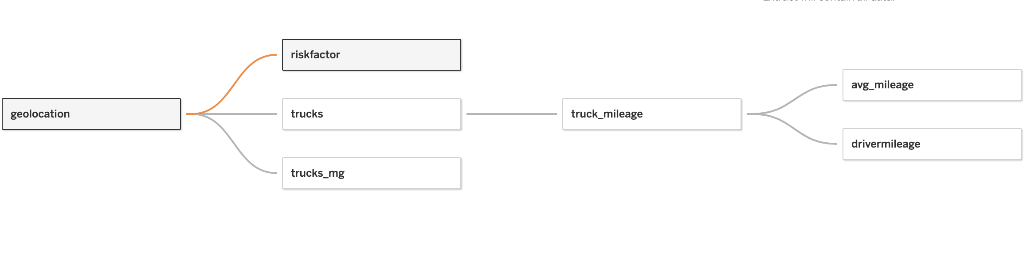
Data Model

Slide 5
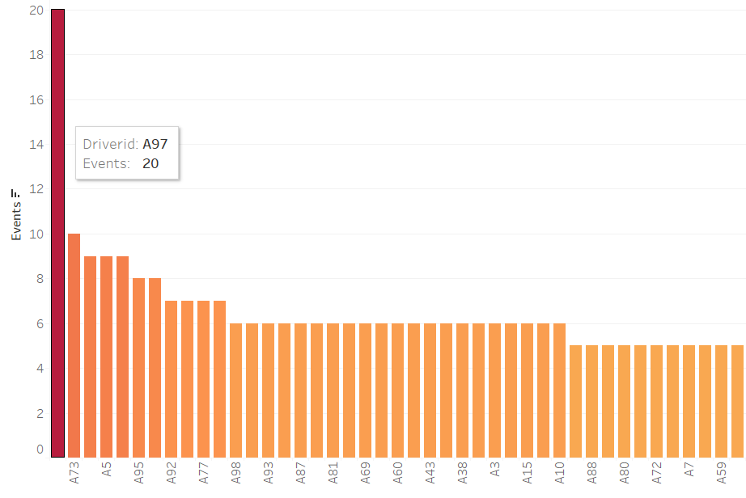
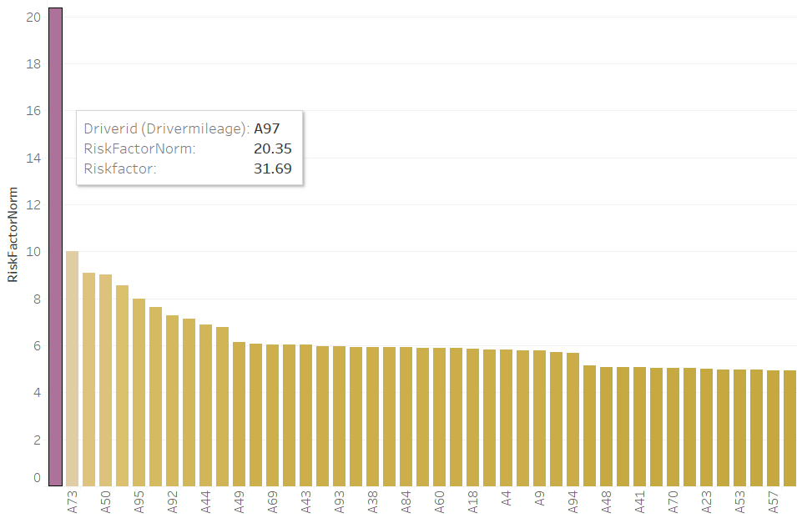
Driver ID A97 as an outlier
The Driver ID A97 shows atypical characteristics in terms of the number of events and risk factor, as seen from the bar graphs alongside
Hence, Driver ID A97 is treated as an outlier for future analyses

Slide 6
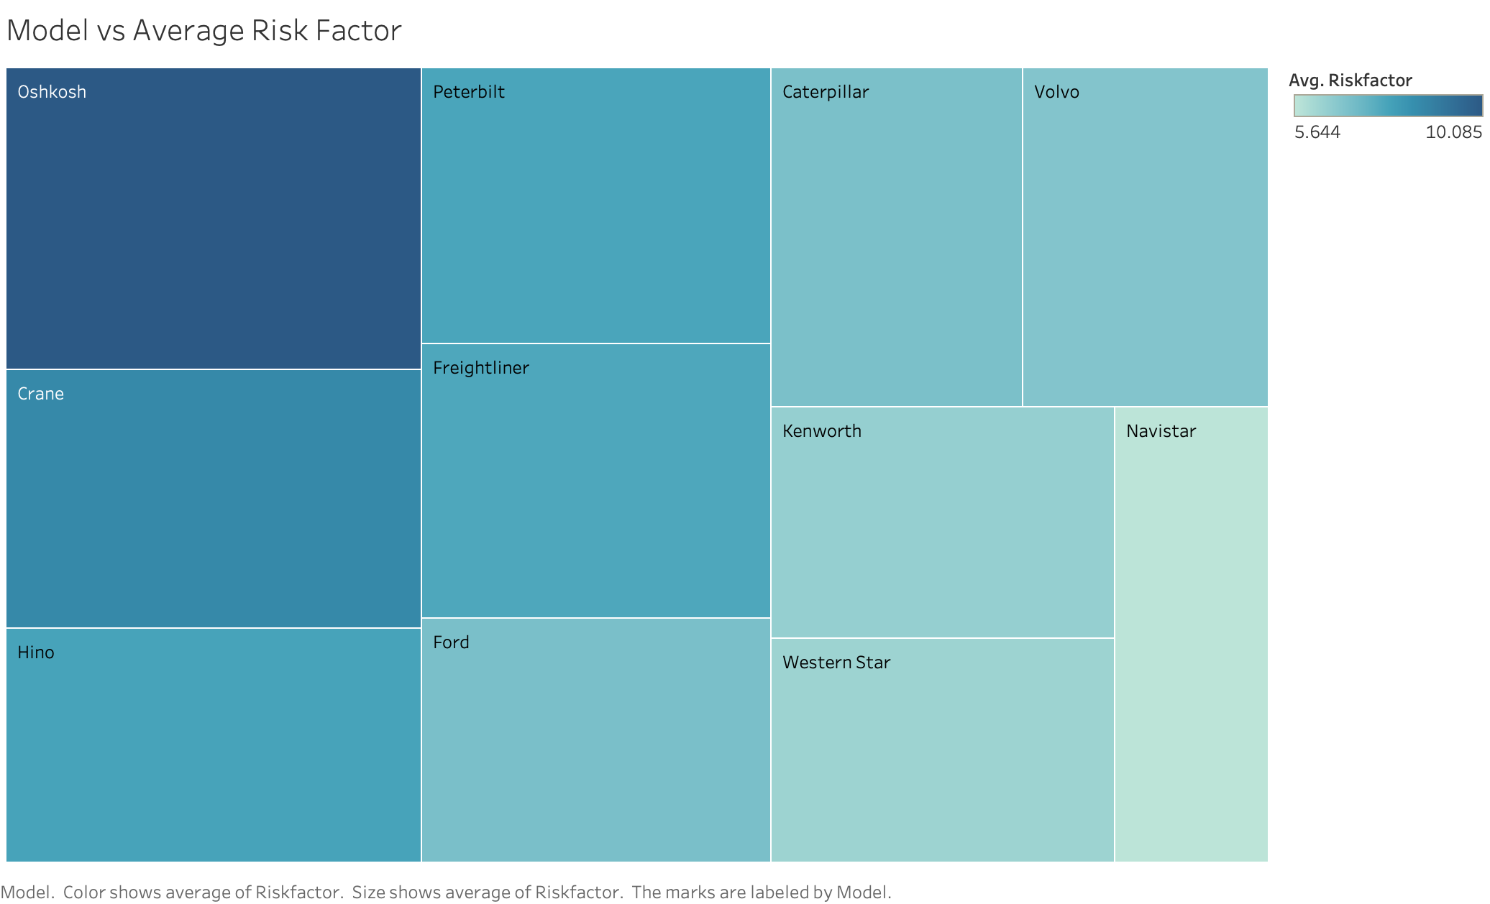
Model vs Avg Risk Factor
The heatmap shows Oshkosh & Crane models have the highest average risk, indicating more frequent high-risk events.
Peterbilt, Caterpillar, Freightliner, and Hino exhibit moderate average risk factors, suggesting a notable but lesser tendency towards risk.
Navistar & Western Star have the lowest average risk factor.
The variation in risk factors across models may reflect differences in design, operational contexts, or usage scenarios, emphasizing the need for targeted risk mitigation strategies.

Slide 7
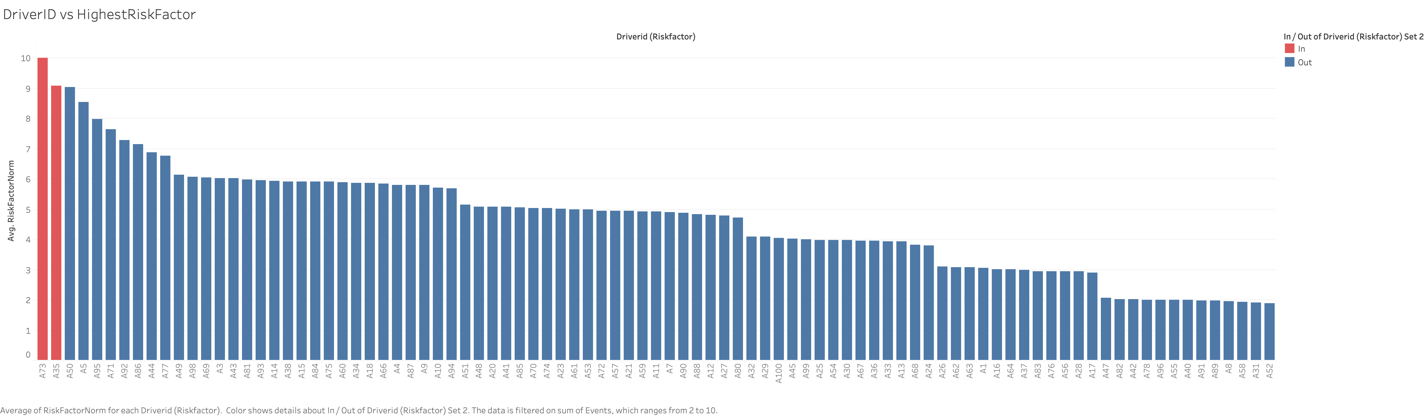
Areas where Driver ID with high Risk Factor are more prone to accidents
Driver IDs A35 and A73 stand out with the highest risk factors, significantly elevating the average risk for Oshkosh and Crane models.
Other drivers in the high-risk category perform relatively well, showing lower risk factors despite being part of the same group.
The data suggests that risk factors are likely influenced more by driver behavior than by the specific vehicle models

Slide 8
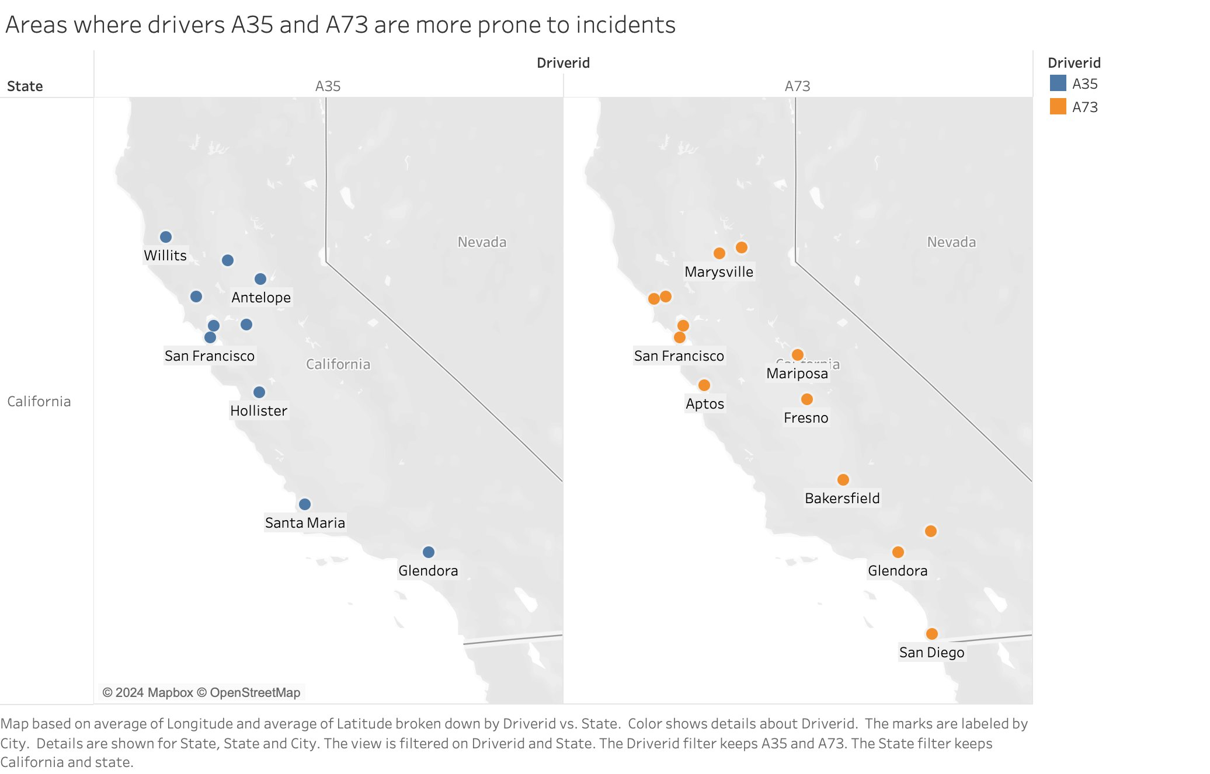
Areas where Driver ID with high Risk Factor are more prone to accidents
The map illustrates the geographical spread of incidents involving drivers with high-risk factors
Insights: The graph reveals the clusters in cities such as San Francisco and Glendora, indicating that certain areas are more susceptible to incidents involving high-risk drivers

Slide 9
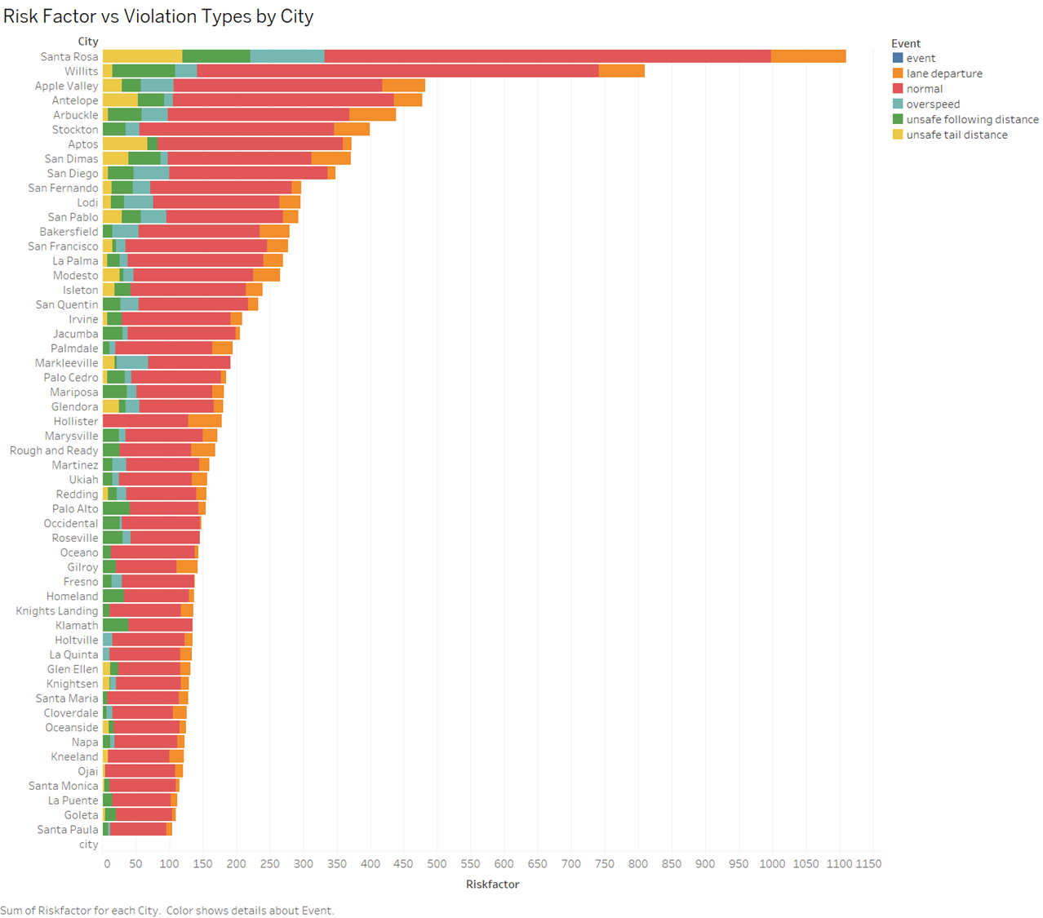
Risk Factor vs Violation Type
Santa Rosa leads with highest risk (1150), followed by Willits & Apple Valley
Top cities account for 30% of total risk factors
Metropolitan areas show higher risk scores vs. smaller cities
Lane departure + normal events dominate risk patterns.
Major cities show 3x higher risk than small cities.

Slide 10
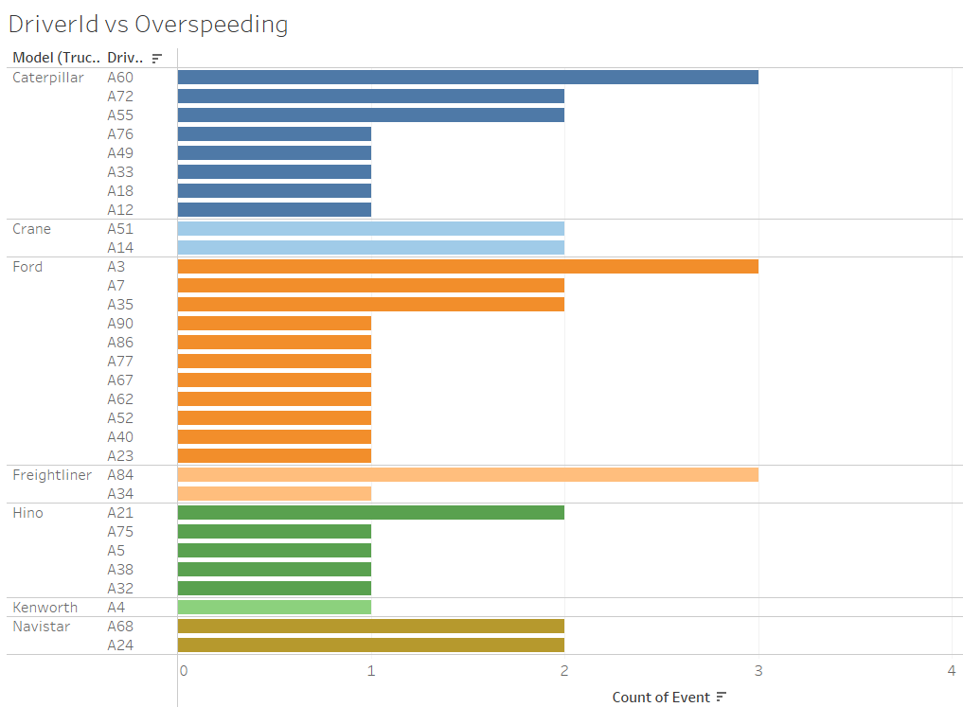
Driver ID vs Overspeeding
Model Variation:
Caterpillar and Ford models show higher overspeeding incidents compared to Freightliner, Hino, Kenworth, and Navistar.
Driver-Specific Trends:
Certain drivers exhibit a higher tendency towards overspeeding, particularly in the Caterpillar and Ford categories.

Slide 11
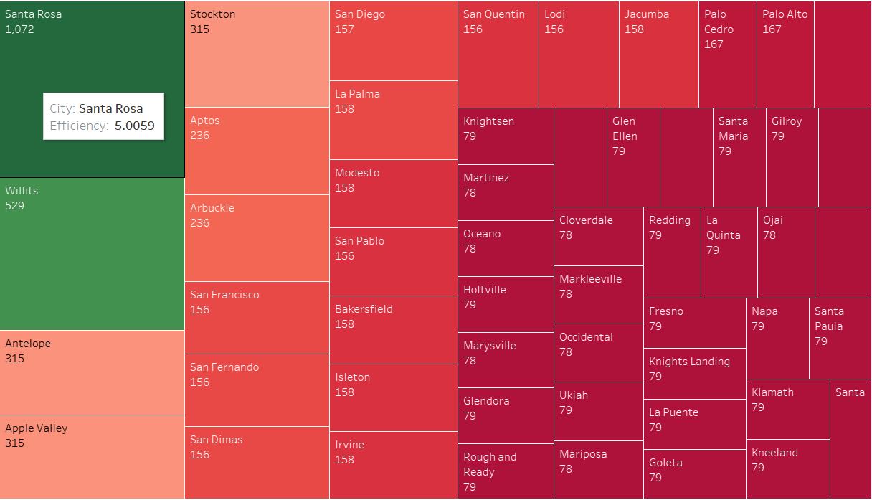
Efficiency Analysis per city
The Efficiency analysis per city is conducted by calculating Mileage per Fuel Consumption ratio
In terms of efficiency, Santa Monica proves to be the most efficient city with an efficiency rate of 5.22
Santa Rosa tops the list of highest occurrences of events with a count of 1072 events, followed by Willits with 529 events

Slide 12
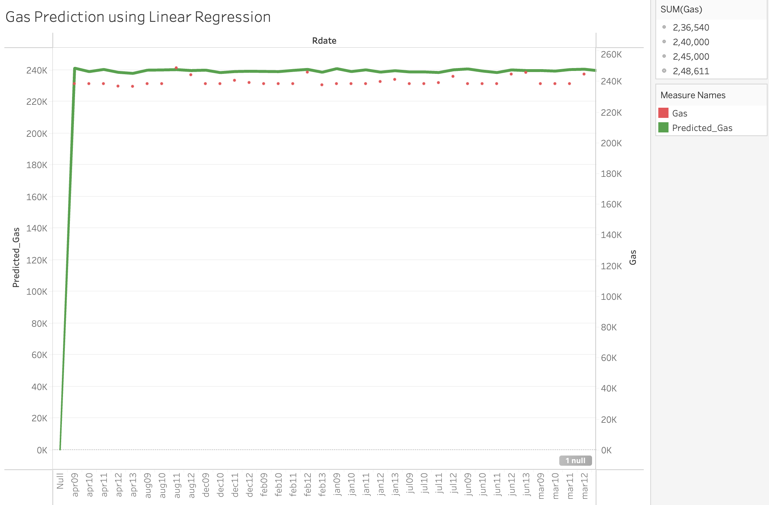
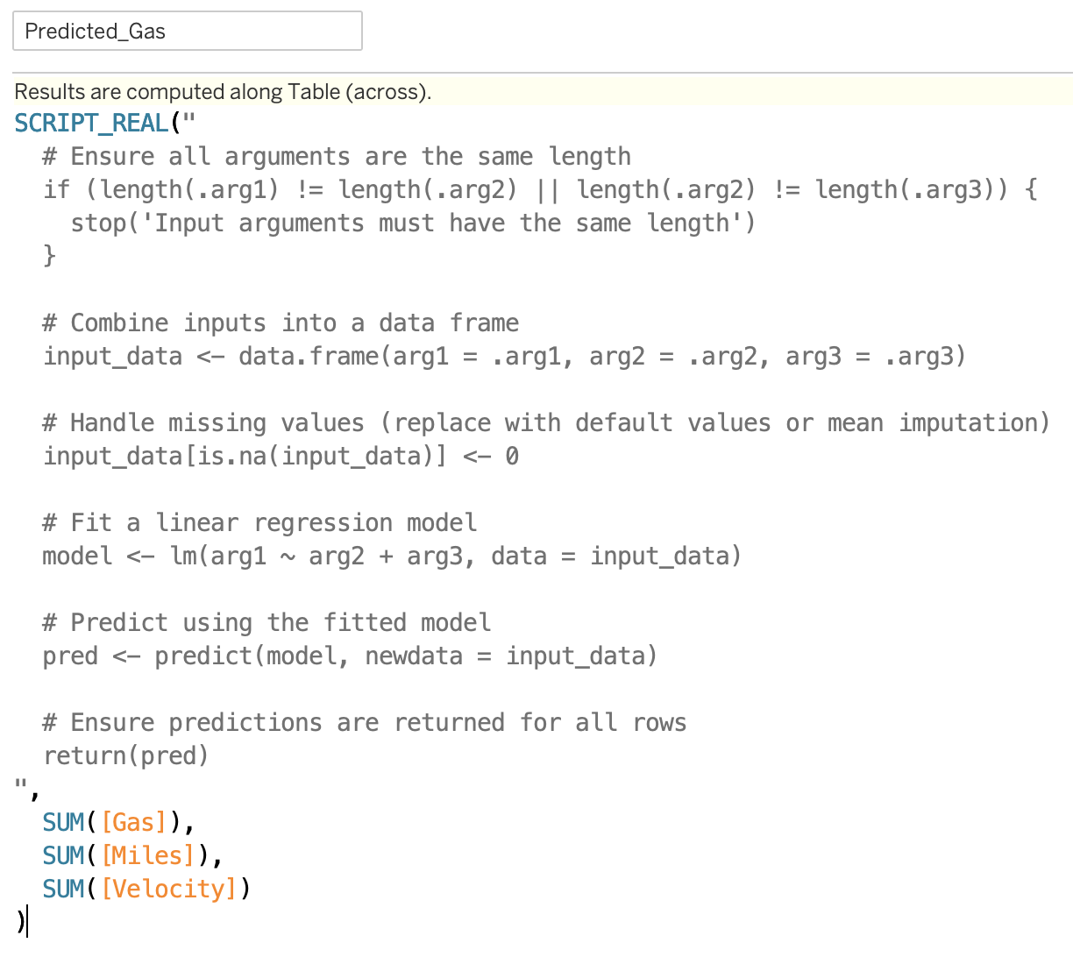
Predicting Gas using Linear Regression in R
The following variables were used in the prediction:
Miles
Average Velocity

Slide 13
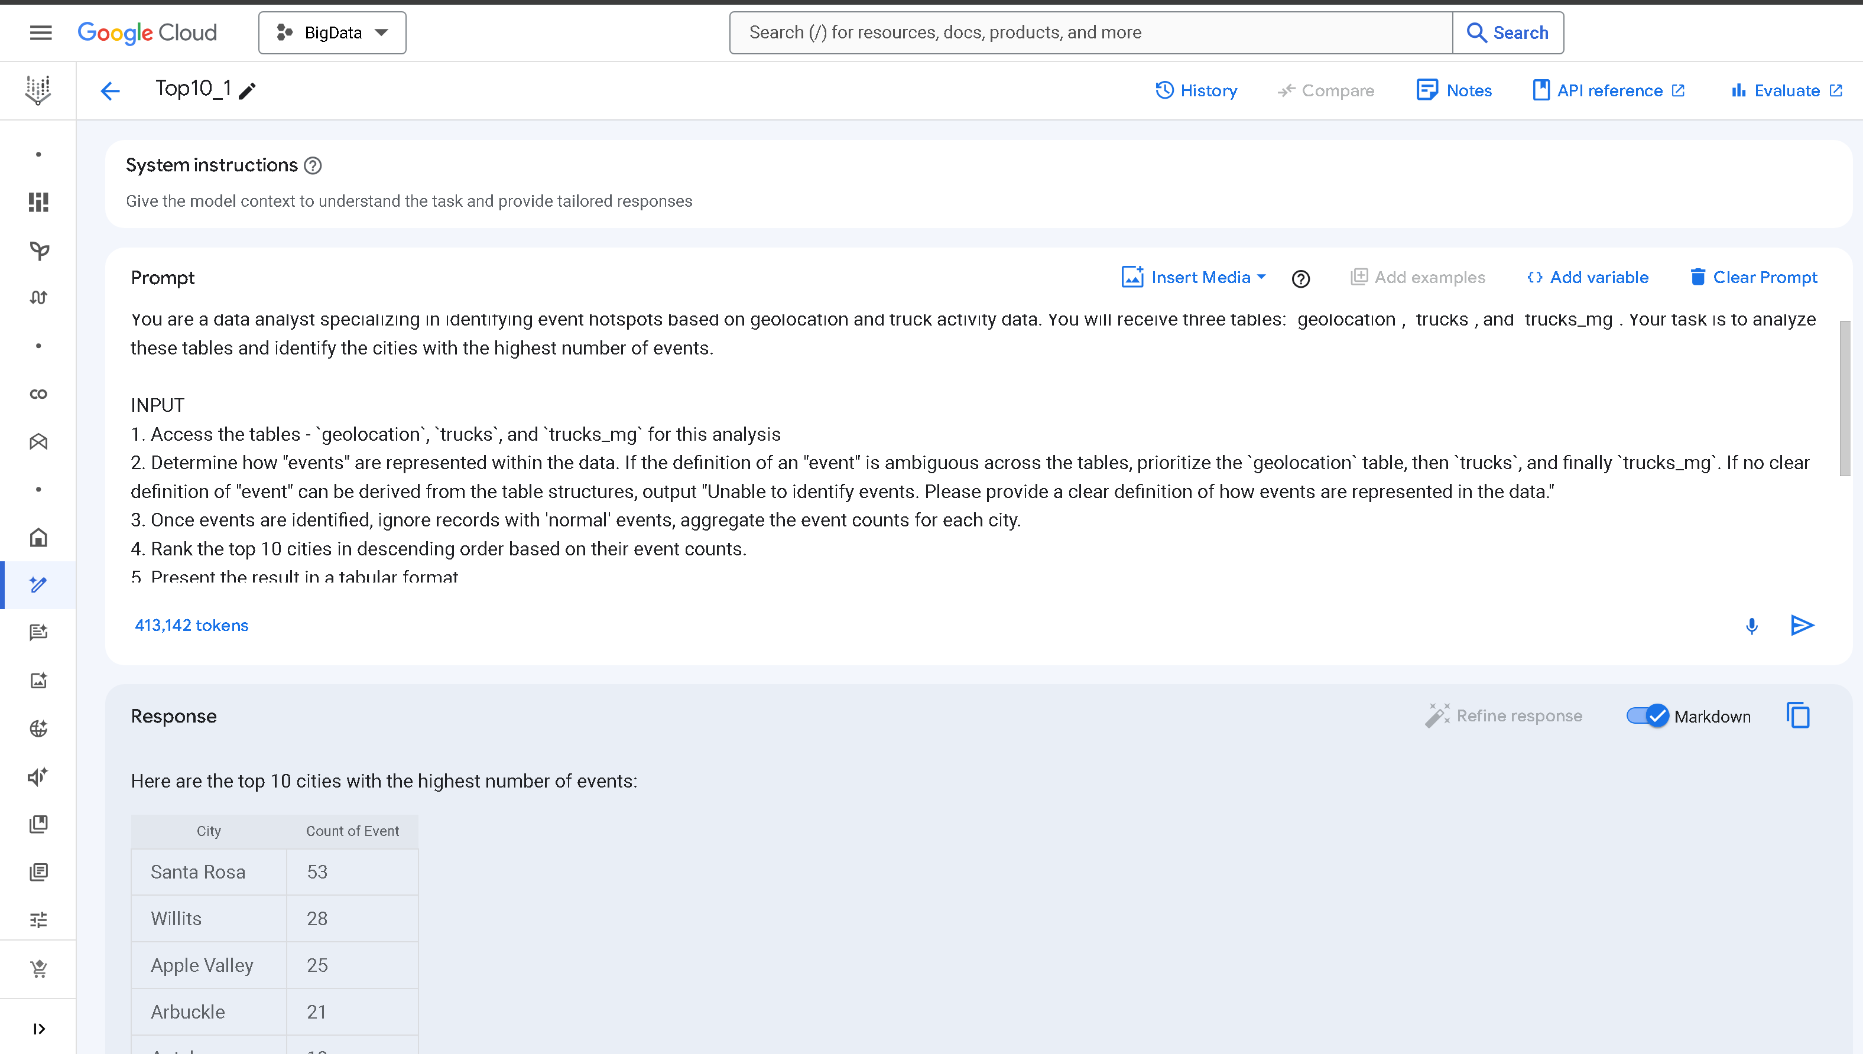
Vertex AI - Top 10 cities with most Events
Vertex AI provided with 3 tables: geolocation, trucks, trucks_mg
Vertex AI used to analyze data and find top 10 cities with highest number of events.
Vertex AI is provided with a prompt with detailed steps explaining the dataset and analysis to be done

Slide 14
Conclusion
Our analysis indicates that the truck model significantly influences the risk factor, in addition to the driver's role.
Replacing these models could help reduce violations and enhance safety.
Furthermore, we found a positive correlation between the risk factor and the frequency of abnormal events.
Reducing these incidents is likely to lower the risk.
This can be achieved by providing additional training to drivers in cities with higher risk levels and more frequent incidents.

Slide 15

THANK YOU

